Slide 1

AI 014 Special Topics-Auto.Mach.Learn
the 7 Kinds of Data Stories
By Zeyu Wang
Fall 2021

Slide 2
1. Change Over Time

Slide 3
1. Change Over Time

Slide 4
1. Change Over Time

Slide 5
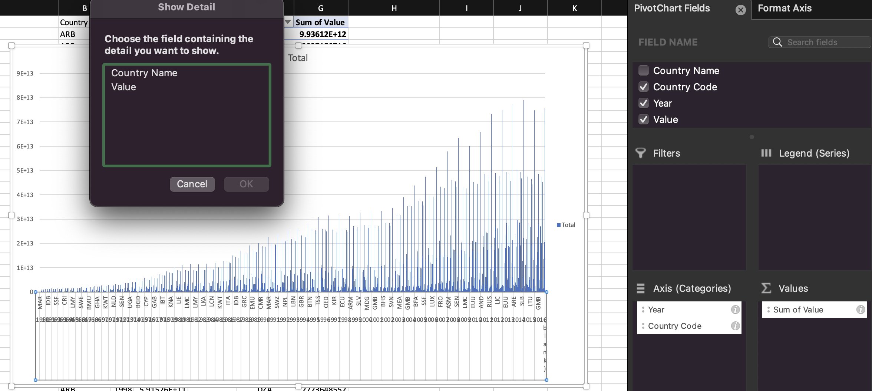
2. Drill Down

Slide 6
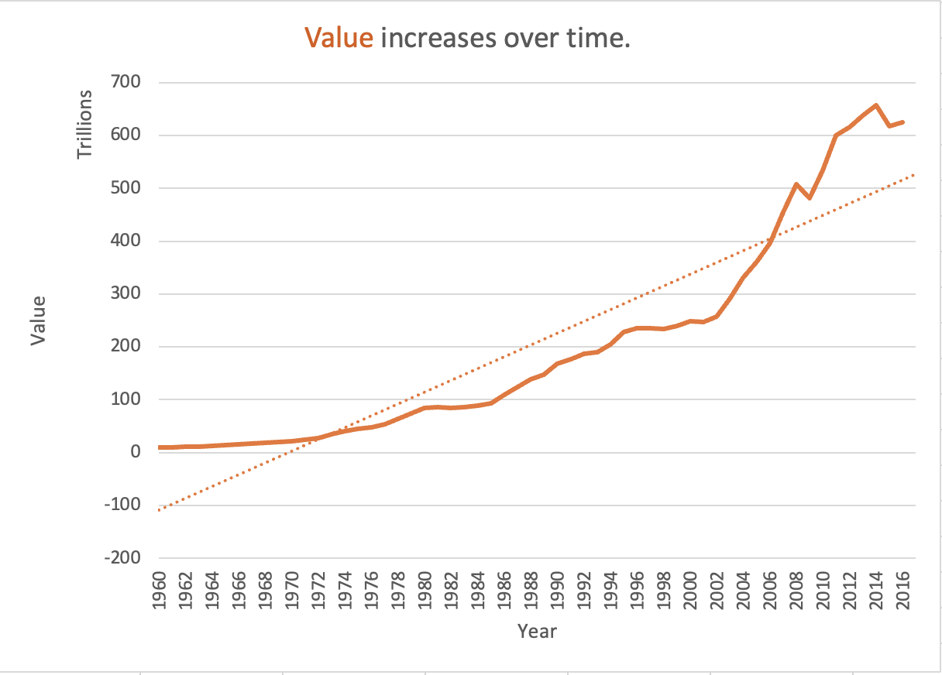
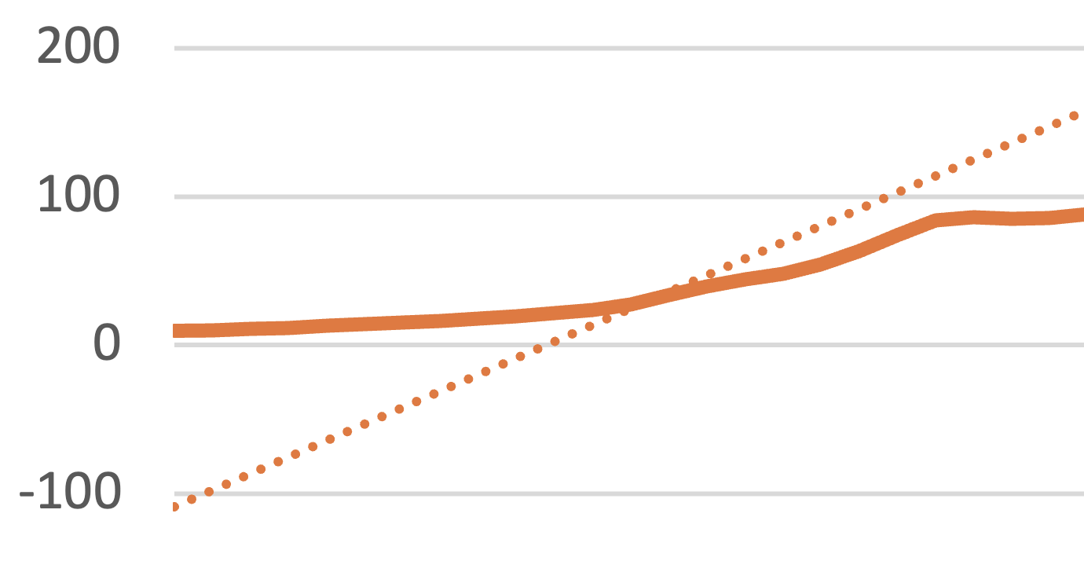
3. Zoom Out

Slide 7
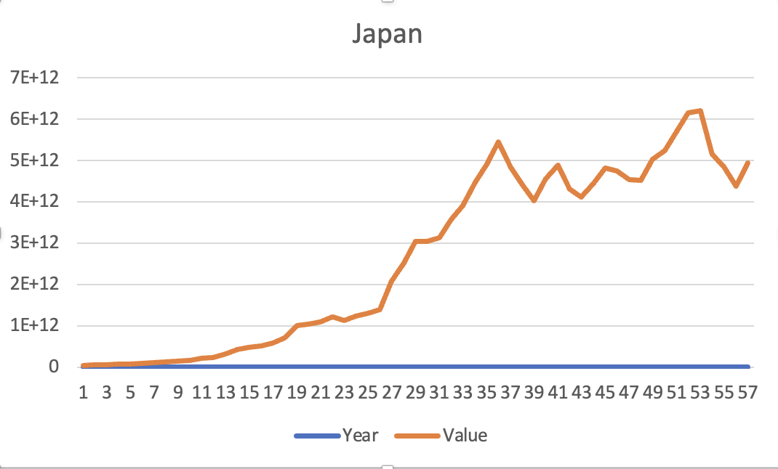
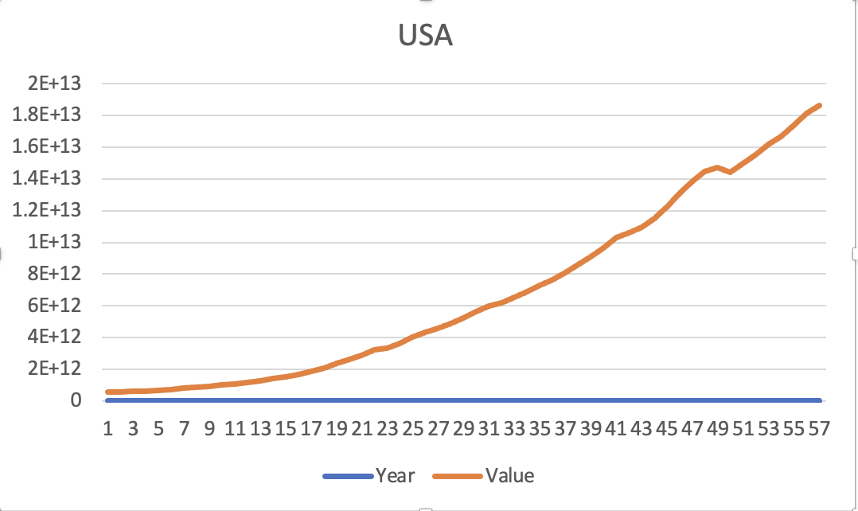
4. Contrast

Slide 8
5. Intersections

Slide 9
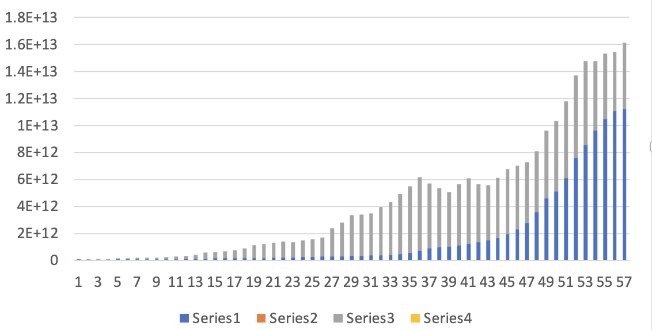
6. Factors

Slide 10
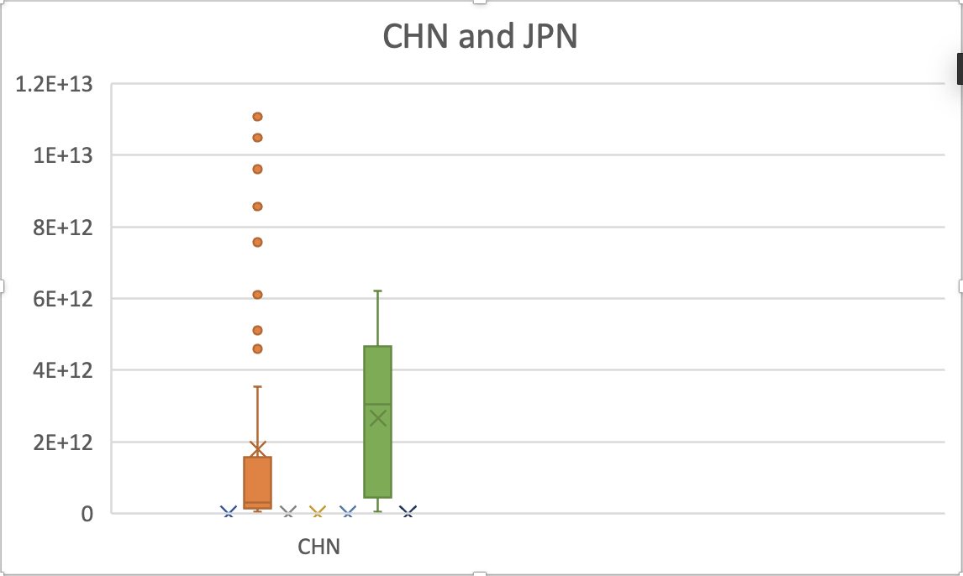
7. Outliers

